Slide 1
Logic Design

Slide 2
Topics
- Gates, Truth Tables, and Logic Equations
- Combinational Logic
- Using a Hardware Description Language
- Constructing a Basic Arithmetic Logic Unit
- Faster Addition: Carry Lookahead
- Clocks
- Memory Elements: Flip-flops, Latches, and Registers
- Memory Elements: SRAMs and DRAMs
- Finite State Machines
- Timing Methodologies
- Field Programmable Devices

Slide 3
Digital Design Basics
Two voltage levels – high and low (1 and 0, true and false)
Hence, the use of binary arithmetic/logic in all computers
A transistor is a 3-terminal device that acts as a switch
V
V
0
V
V
Conducting
0
Non-conducting
0
0

Slide 4
Logic Blocks
A logic block has a number of binary inputs and produces
a number of binary outputs – the simplest logic block is
composed of a few transistors
A logic block is termed combinational if the output is only
a function of the inputs
A logic block is termed sequential if the block has some
internal memory (state) that also influences the output
A basic logic block is termed a gate (AND, OR, NOT, etc.)

Slide 5
Truth Tables
A table of all possible inputs and the associated outputs for a particular circuit
All combinational logic can be completely described using a truth table
Non-zero output truth tables only list the inputs that result in non-zero outputs
Text example: for all values of A, B, and C, let D be true if at least one input is true, let E be true if exactly two inputs are true, and let F be true only if all three inputs are true.

Slide 6
Boolean Algebra
binary OR is written +
logical sum
result is 1 if at least one variable is 1
binary AND is written *
logical product
result is 1 only if both variables are 1
unary NOT is written A

Slide 7
Boolean Algebra Laws
Identity law : A + 0 = A ; A * 1 = A
Zero and One laws : A + 1 = 1 ; A * 0 = 0
Inverse laws : A + A = 1 ; A * A = 0
Commutative laws : A + B = B + A ; A * B = B * A
Associative laws : A + (B + C) = (A + B) + C ;
A * (B * C) = (A * B) * C
Distributive laws : A * (B + C) = (A * B) + (A * C) ;
A + (B * C) = (A + B) * (A + C)

Slide 8
DeMorgan’s Theorems
DeMorgan developed a pair of important rules regarding group complementation in Boolean algebra. A long bar over more than one variable.
____ _ _
A + B = A * B
____ _ _
A * B = A + B
Try to prove DeMorgan’s Theorems using a truth table!

Slide 9
Gates
A gate is a device that implements basic logic functions, such as AND or OR.
Logic blocks are built from gates that implement basic logic functions.
Since AND is commutative and associative, an AND gate can have multiple inputs, with the output equal to the AND of all the inputs.
The same is true of OR.
The logical function NOT is implemented with an inverter that always has a single input.

Slide 10
Gates
AND OR NOT
What logic function is this?

Slide 11
NAND and NOR Gates
In fact, all logic functions can be constructed with only a single gate type, if that gate is inverting.
The two common inverting gates are called NOR and NAND and correspond to inverted OR and AND gates, respectively.
NOR and NAND gates are called universal, since any logic function can be built using this one gate type.

Slide 12
Combinational Logic
Decoders
Multiplexors
Two-Level Logic and PLAs
ROMs
Don’t Cares
Arrays of Logic Elements

Slide 13
Decoders
A decoder is a logic block that has an n-bit input and 2n outputs where only one output is asserted for each input combination.

Slide 14
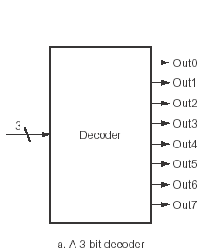
A 3-to-8 decoder

Slide 15
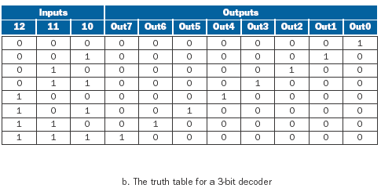
3-to-8 decoder Truth Table

Slide 16
Multiplexors
A basic logic function that is used quite often
A multiplexor could be called a selector
its output is one of the inputs
the input which is to be output is selected by a special input
A selector value (or control value) is the control signal that is used to select one of the input values of a multiplexor as the output of the multiplexor.

Slide 17

Two-Input Multiplexor
How we draw it!
The implementation with gates!

Slide 18
Two-Level Logic and PLAs
Any logic function can be implemented with only AND, OR, and NOT functions.
A canonical form is used, where every input is either a true or complemented (inverted) variable and there are only two levels of gates
one AND and the other OR
with a possible inversion on the final output
The sum of products is a logical representation that uses a logical sum (OR) of products (terms using AND).

Slide 19
Programmable Logic Array
A programmable logic array (PLA) is a structured-logic element composed of a set of inputs and corresponding input complements and two stages of logic
the first stage generates product terms of the inputs and input complements
the second stage generates sum terms of the product terms
Minterms (or product terms) are a set of logic inputs joined by conjunction (AND)
Product terms form the first logic stage of a PLA.

Slide 20
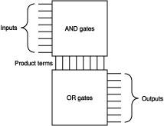
Programmable Logic Array

Slide 21
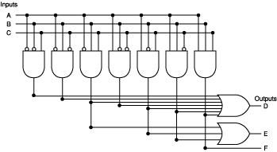
Programmable Logic Array

Slide 22
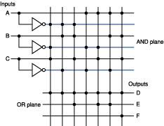
Programmable Logic Array

Slide 23
ROMs
A read-only memory (ROM) is a memory whose contents are designated at creation time, after which the contents can only be read
ROMs can be used as structured logic to implement a set of logic functions
use the terms in the logic functions as address inputs
use the outputs as bits in each memory word
A programmable ROM (PROM) is a form of ROM that can be programmed when a designer knows what to put into it

Slide 24
Don’t Cares
A “don’t care” is a situation where we do not care what the value of some input or some output
“Don’t cares” occur often in implementing some combinational logic
We don’t care about an input or output either because another output is true or because a subset of the input combinations determines the values of the outputs

Slide 25
Arrays of Logic Elements
Many of the combinational operations to be performed on data have to be done to an entire word (32 bits) of data.
A bus is a collection of data lines that is treated together as a single logical signal (also, a shared collection of lines with multiple sources and uses)

Slide 26
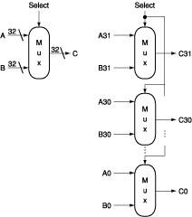
A Multiplexor that selects between two 32-bit buses

Slide 27
Hardware Description Language
A programming language for describing hardware, used for generating simulations of a hardware design and also as input to synthesis tools that can generate actual hardware.
Verilog: One of the two most common hardware description languages.
Heavily used in industry. Based on C.
VHDL: More heavily used in industry. Its based on Ada

Slide 28
Constructing a basic ALU
A 1-Bit ALU
A 32-Bit ALU
Tailoring the 32-Bit ALU to MIPS
Defining the MIPS ALU in Verilog

Slide 29
A 1-bit ALU
The logical operations are easiest, because they map directly onto the hardware components:
AND gate
OR gate
Inverter

Slide 30
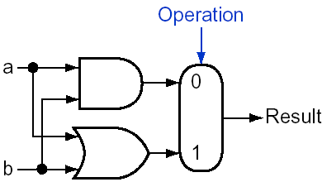
The 1-bit Logical Unit for AND and OR

Slide 31
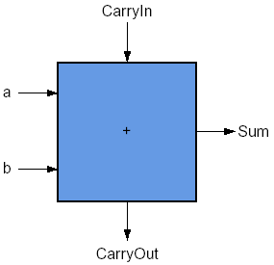
A 1-bit Adder

Slide 32
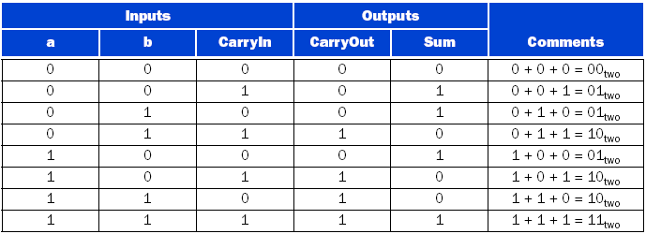
Input and Output Specification for a 1-bit Adder
Notes:
C + B + A + ABC = 1

Slide 33
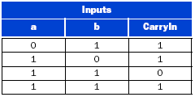
Values of the Inputs When CarryOut is a 1
Notes:
BC + AC + AB + ABC = 1

Slide 34
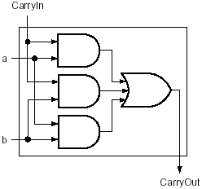
Adder Hardware for the CarryOut signal

Slide 35
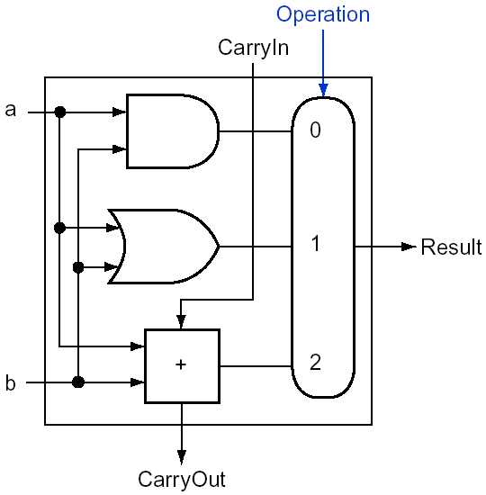
A 1-bit ALU that Performs AND, OR, and Addition

Slide 36
A 32-bit ALU
Now that we have completed the 1-bit ALU, the full 32-bit ALU is created by connecting adjacent “black boxes.”

Slide 37
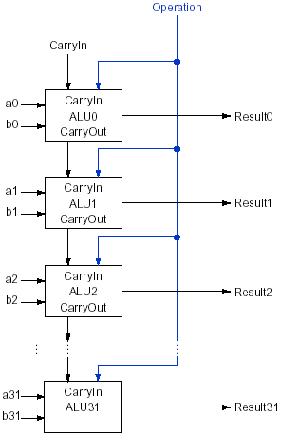
A 32-bit ALU Constructed from 32 1-bit ALUs

Slide 38
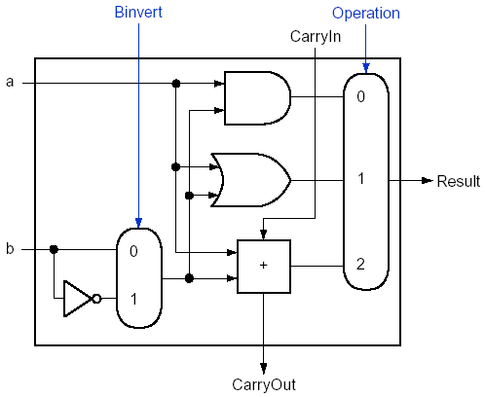
1-bit ALU that ANDs, ORs, or ADDs a and b or a and ~b

Slide 39
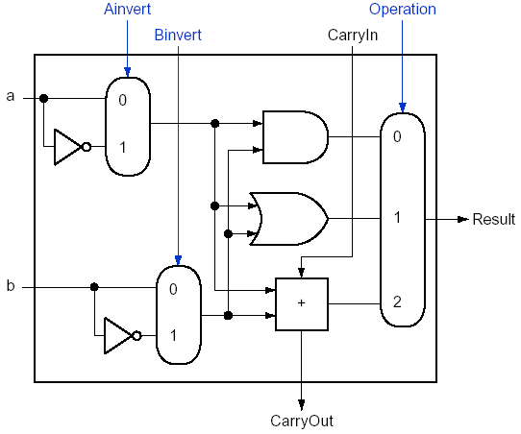
1-bit ALU that ANDs, ORs, or ADDs a or ~a with b or ~b

Slide 40
Adding a Comparison Function to the 32-Bit ALU
The four operations—add, subtract, AND, OR—are found in the ALU of almost every computer, and the operations of most instructions can be performed by this ALU. But the design of the ALU is incomplete.
One instruction that still needs support is the a comparison function:
set on less than (slt).

Slide 41
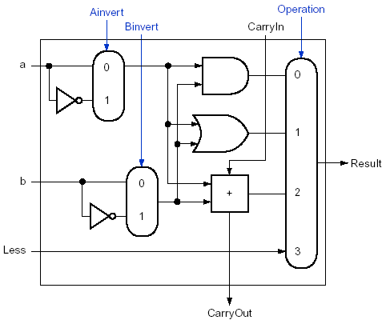
1-bit ALU: ANDs, ORs, ADDs, and Compares a or ~a, b or ~b

Slide 42
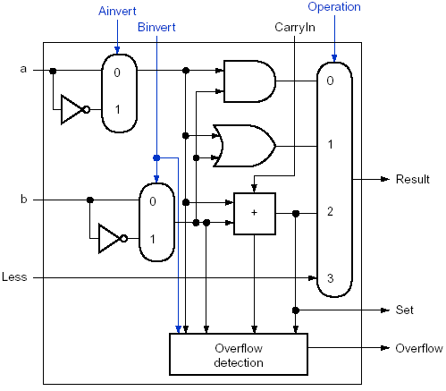
1-bit ALU for the Most Significant Bit

Slide 43
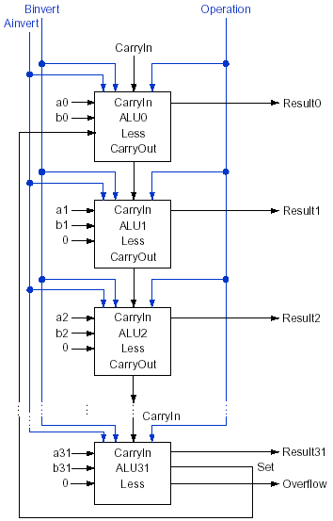
A 32-bit ALU Constructed from 31 copies of the 4-function 1-bit ALU and one special 4-function 1-bit ALU for the Most Significant Bit
Notes:
0003
=> 0011
3000
=> 101111111111

Slide 44
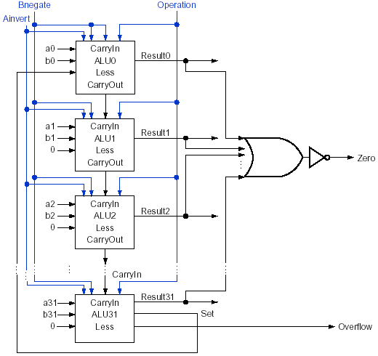
The Final 32-bit ALU

Slide 45
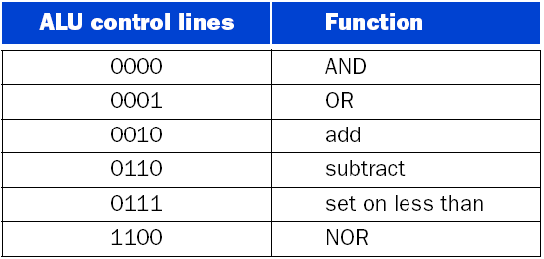
The values of the three ALU control lines Bnegate and Operation and the corresponding ALU operations

Slide 46
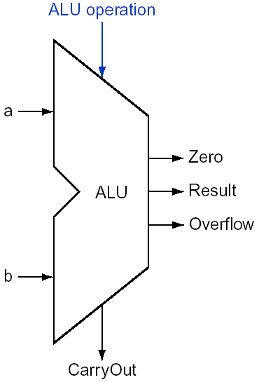
The Symbol Commonly Used to Represent an ALU

Slide 47
Faster Addition: Carry Lookahead
Fast Carry Using “Infinite” Hardware
Fast Carry Using the First Level of Abstraction: Propagate and Generate
Fast Carry Using the Second Level of Abstraction
Summary

Slide 48
Fast Carry Using “Infinite” Hardware
c2 = (b1*c1)+(a1*c1)+(a1*b1)
c1 = (b0*c0)+(a0*c0)+(a0*b0)
c2 = (a1*a0*b0)+(a1*a0*c0)+(a1*b0*c0)
+(b1*a0*b0)+(b1*a0*c0)+(b1*b0*c0)
+(a1*b1)
Imagine how the equation expands as we get to higher bits in the adder!
This complexity causes high hardware cost for fast carry, making this simple scheme prohibitively expensive for wide adders.

Slide 49
Fast Carry Using the First Level of Abstraction: Propagate and Generate
Most fast carry schemes limit the complexity of the equations to simplify the hardware, while still making substantial speed improvements over ripple carry.
One such scheme is a carry-lookahead adder
There are two important factors called generate(gi) and propagate (pi):
gi = ai*bi
pi = ai+bi

Slide 50
Propagate and Generate
The adder generates a CarryOut (ci+1) independent of the value of CarryIn (ci).
The adder propagates CarryIn to a CarryOut.
Putting the two together,
CarryIni+1 is a 1 if
either
gi is 1
or
both pi is 1 and CarryIni is 1

Slide 51
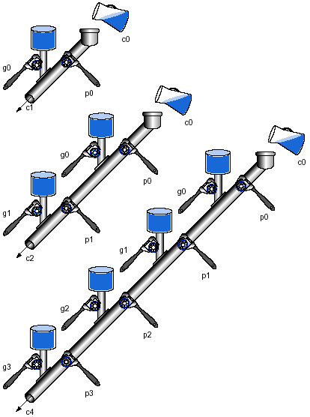
A plumbing analogy for carry lookahead for 1 bit, 2 bits, and 4 bits using water pipes and valves.

Slide 52
Fast Carry Using the Second Level of Abstraction
Use a 4-bit adder with its carry-lookahead logic as a single building block
If we connect them in ripple carry fashion to form a 16-bit adder, the add will be faster than the original with a little more hardware
To go faster, we’ll need carry lookahead at a higher level
To perform carry lookahead for 4-bit adders, we need propagate and generate signals at this higher level

Slide 53
Propagate and Generate
P0 = p3 * p2 * p1 * p0
P1 = p7 * p8 * p5 * p4
P2 = p11 * p10 * p9 * p8
P3 = p15 * p14 * p13 * p12
G0 = g3 +(p3 *g2 )+(p3 *p2 *g1 )+(p3 *p2 *p1 *g0 )
G1 = g7 +(p7 *g6 )+(p7 *p6 *g5 )+(p7 *p6 *p5 *g4 )
G2 = g11+(p11*g10)+(p11*p10*g9 )+(p11*p10*p9 *g8 )
G3 = g15+(p15*g14)+(p15*p14*g13)+(p15*p14*p13*g12)

Slide 54
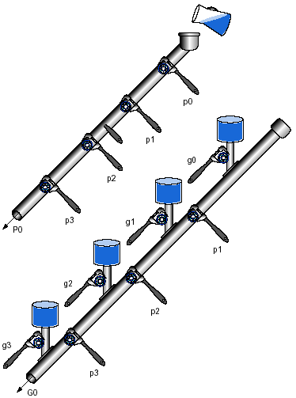
A plumbing analogy for the next-level carry-lookahead signals P0 and G0.

Slide 55
Final Carry Equations
C1 = G0+(P0*c0)
C2 = G1+(P1*G0)+(P1*P0*c0)
C3 = G2+(P2*G1)+(P2*P1*G0)+(P2*P1*P0*c0)
C4 = G3+(P3*G2)+(P3*P2*G1)+(P3*P2*P1*G0) +(P3*P2*P1*P0*c0)

Slide 56
Summary
Carry lookahead adders are faster than ripple-carry adders.
This speed is generated by two signals:
generate
propagate
Generate creates a carry regardless of the carry input
Propagate passes a carry along
Carry lookahead is another example of how abstraction is important in computer design in order to cope with complexity

Slide 57
Speed of Ripple Carry vs Carry Lookahead
Assume the propagation delay of a signal passing through each gate is the same time.
Time is estimated by simply counting the number of gates along the path through a piece of logic.
Compare the number of gate delays for paths of two 16-bit adders, one using ripple carry and one using two-level carry lookahead.

Slide 58
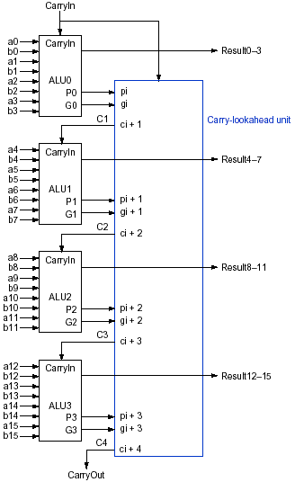
Four 4-bit ALUs Using Carry Lookahead To Form A 16-bit Adder

Slide 59
Clocks
Edge-triggered clocking is a clocking scheme in which all state changes occur on a clock edge.
Clocking methodology is the approach used to determine when data is valid and stable relative to the clock.
State element is a memory element.
Synchronous system is a memory system that employs clocks and where data signals are read only when the clock indicates that the signal values are stable.

Slide 60
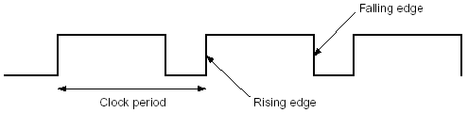
The Clock Signal

Slide 61
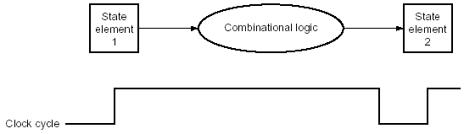
State Elements

Slide 62

Edge-Triggered Methodology

Slide 63
Register Files
A register file is a state element that consists of a set of registers that can be read and written by supplying a register number to be accessed.

Slide 64
Memory Elements
Flip-Flops and Latches
Register Files
Specifying Sequential Logic in Verilog

Slide 65
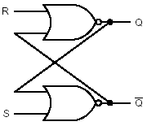
Cross-Coupled NOR Gates

Slide 66
Flip-Flops and Latches
flip-flop is a memory element for which the output is equal to the value of the stored state inside the element and for which the internal state is changed only on a clock edge.
latch is a memory element in which the output is equal to the value of the stored state inside the element and the state is changed whenever the appropriate inputs change and the clock is asserted.

Slide 67
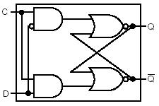
D Latch Logic Circuit

Slide 68
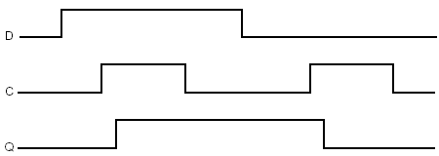
D Latch Timing Diagram

Slide 69
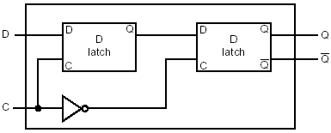
D Flip-Flop
A D flip-flop is a flip-flop with one data input that stores the value of that input signal in the internal memory when the clock edge occurs.

Slide 70
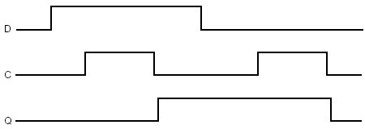
D Flip-flop Timing Diagram
Falling-edge Trigger

Slide 71
Flip-Flops and Latches
Timing Measurements
Set-up time is the minimum time that the input to a memory device must be valid before the clock edge.
Hold time is the minimum time during which the input must be valid after the clock edge.

Slide 72
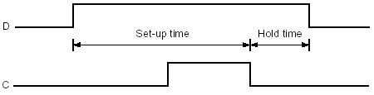
D Flip-flop Set-up & Hold
Falling-edge Trigger

Slide 73
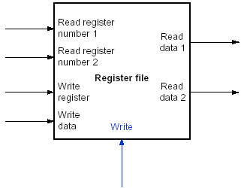
Register Files

Slide 74
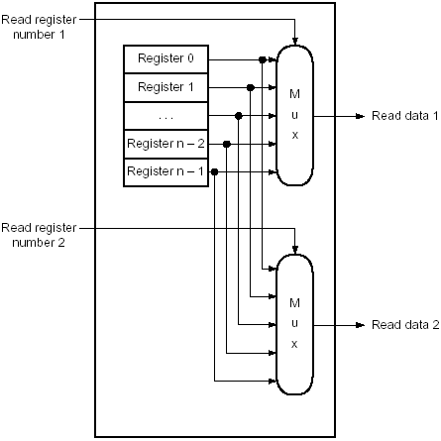
Two Read Ports

Slide 75
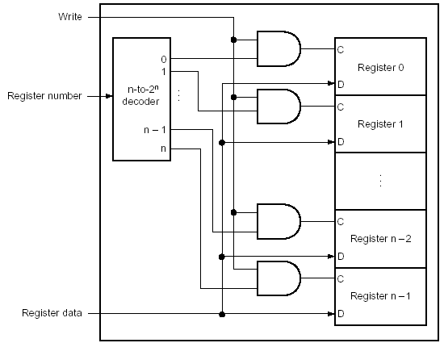
Write Port

Slide 76
Memory Elements: SRAMs and DRAMs
Static RAM (SRAM) is random access memory where data is stored in static circuits (as in flip-flops) and does not need to be refreshed.
Dynamic RAM (DRAM) is random access memory where data is stored in dynamic circuits (as in capacitors) and needs to be refreshed periodically to keep its values.
SRAMs are faster than DRAMs, but less dense and more expensive per bit.

Slide 77
SRAMs
SRAMs are simply integrated circuits that are memory arrays with (usually) a single access port that can provide either a read or a write. SRAMs have a fixed access time to any datum, though the read and write access characteristics often differ.
A SRAM chip has a specific configuration in terms of the number of addressable locations, as well as the width of each addressable location.

Slide 78
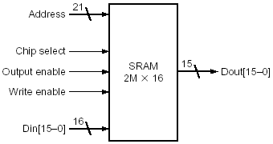
SRAMs
A 32K x 8 SRAM showing the fifteen address lines (32K = 215) and eight data inputs, the three control lines, and the eight data outputs.

Slide 79
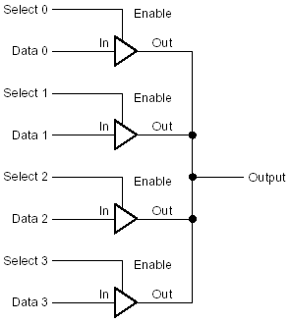
Four three-state buffers used to form a multiplexor

Slide 80
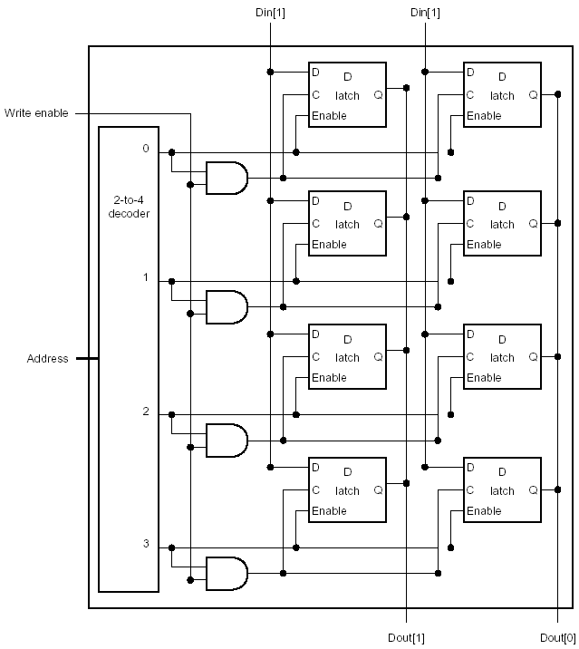
The basic structure of a 4 x 2 SRAM consists of a decoder that selects which pair of cells to activate

Slide 81
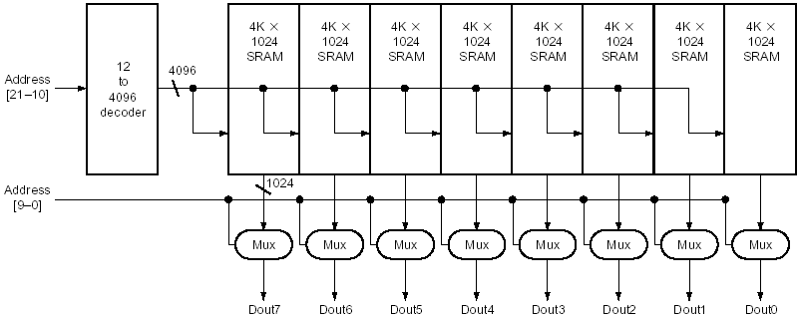
Typical organization of a 4M x 8 SRAM as an array of 4K x 1024 arrays

Slide 82
DRAMs
In a Dynamic RAM (DRAM), the value kept in a cell is stored as a charge in a capacitor.
A single transistor is used to access this stored charge, either
to read the value, or
to overwrite the charge stored there

Slide 83
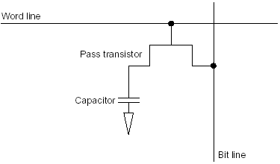
A single-transistor DRAM cell
A single-transistor DRAM cell contains
a capacitor that stores the cell contents
a transistor used to access the cell

Slide 84
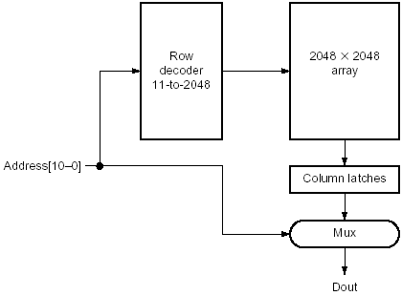
A 4M x 1 DRAM Built With a 2048 x 2048 Array

Slide 85
SDRAM
Synchronous DRAM is high speed output DRAM, which changes the column address without changing the row address and clocks address inputs to increase speed and precision
Since 1999, SDRAM is the most used form of RAM in cache-based main memory
Since 2004, DDRRAM (Double Data Rate RAMs), which transfers data on both the rising and falling edge of the clock, is the most used form of SDRAM

Slide 86
Error Correction
An error-detecting code (EDC) is a code that enables the detection of an error in data, but not the precise location, and hence correction of the error.
An error-correcting code (ECC) is a code that enables the detection of an error in data and the determination of the precise location of the error, which allows correction of the error.

Slide 87
Error Detection vs.
Error Correction
A 1-bit parity code is a distance-2 code
No 1-bit change can generate another legal combination of data plus parity
After any 2-bit change in data plus parity, the parity will match the data and the error cannot be detected
A distance-3 code can detect more than one error or correct an error
Legal combinations of data plus ECC have at least 3 bits differing from any other legal combination
Two errors can be recognized, but we cannot correct the errors

Slide 88
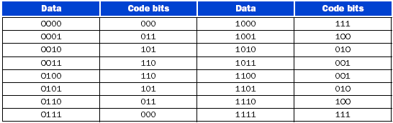
Distance-3 Error Correction Code
Here are the data words and a distance-3 error correction code for a 4-bit data item.

Slide 89
Finite State Machines
A finite state machine is a sequential logic function consisting of a set of inputs and outputs, a next-state function that maps the current state and the inputs to a new state, and an output function that maps the current state and possibly the inputs to a set of asserted outputs.
A next-state function is a combinational function that, given the inputs and the current state, determines the next state of a finite state machine.

Slide 90
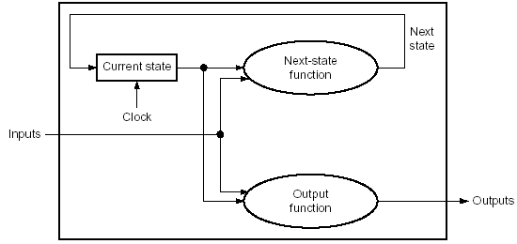
A state machine

Slide 91
Moore vs. Mealy Machines
A Moore machine is a finite state machine whose output function depends on just the current state
A Mealy machine is a finite state machine whose output function depends on both the current state and the current input

Slide 92
Controlling a Traffic Light
Clock = 0.033 Hz
Outputs (asserted=green, deasserted=red)
NSlite
EWlite
Inputs (from sensors embedded in road)
NScar
EWcar
States (indicates green light)
NSgreen
EWgreen

Slide 93
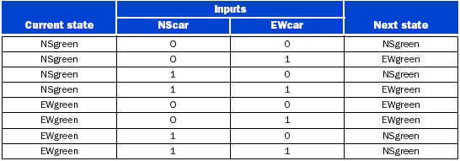
next-state function

Slide 94

output function

Slide 95
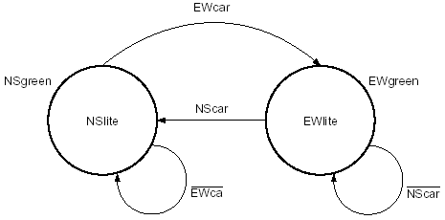
Graphical representation of a finite state machine

Slide 96
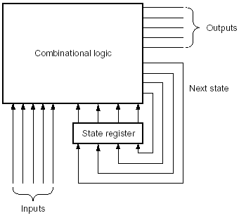
Logical representation of a finite state machine

Slide 97
finite state machine functions
The Next-state Function
__________ _____
NextState = (CurrentState*EWcar) + (CurrentState*NScar)
The Output Functions
__________
NSlite = CurrentState
EWlite = CurrentState

Slide 98
Timing Methodologies
Edge-triggered timing methodology is simpler than a level-triggered methodology.
If all clocks arrive at circuits at the same time, a system with edge-triggered registers between blocks of combinational logic can operate correctly without races, if we simply make the clock long enough.
A race occurs when the contents of a state element depend on the relative speed of different logic elements.

Slide 99
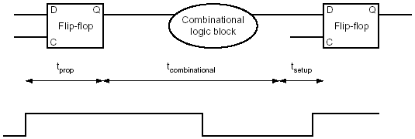
Clock must be long enough

Slide 100


Clock skew
Clock skew is the difference in absolute time between the times when two state elements see a clock edge.

Slide 101
Level-Sensitive timing
In a level-sensitive timing methodology, the state changes occur at either high or low levels, but they are not instantaneous as they are in an edge-triggered methodology.
Because of the noninstantaneous change in state, races can easily occur.
To ensure that a level-sensitive design will also work correctly if the clock is slow enough, designers use two-phase clocking.
Two-phase clocking is a scheme that makes use of two nonoverlapping clock signals.

Slide 102
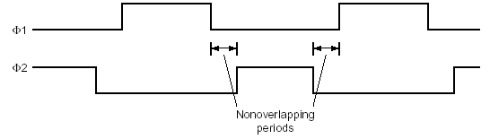
Two-Phase clocking

Slide 103

Two-Phase timing with alternating latches

Slide 104
Asynchronous Inputs and Synchronizers
Metastability is a situation that occurs if a signal is sampled when it is not stable for the required set-up and hold times, possibly causing the sampled value to fall in the indeterminate region between a high and low value.
Synchronizer failure is a situation in which a flip-flop enters a metastable state and where some logic blocks reading the output of the flip-flop see a 0 while others see a 1.

Slide 105

A “Synchronizer”

Slide 106

A Real Synchronizer

